Slide 1
Popular Programming Tech
Part 4
Basic Data Types

Slide 2
Learning Objective
LO 2 : Apply GO programming language techniques and libraries

Slide 3
Outline
Integers
Floating point numbers
Complex numbers
Booleans
Strings
Constants

Slide 4
Integers
Go’s numeric data types include several sizes of integers, floating-point numbers, and complex numbers. Each numeric type determines the size and signedness of its values. Let’s begin with integers.
Go provides both signed and unsigned integer arithmetic. There are four distinct sizes of signed integers—8, 16, 32, and 64 bits—represented by the types int8, int16, int32, and int64, and corresponding unsigned versions uint8, uint16, uint32, and uint64.

Slide 5
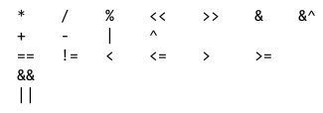
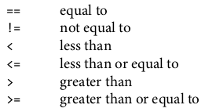
Binary operators
Go’s binary operators for arithmetic, logic, and comparison are listed here in order of decreasing precedence
Two integers of the same type may be compared using the binary comparison operators below; the type of a comparison expression is a boolean.

Slide 6

Type mismatch
This type mismatch can be fixed in several ways, most directly by converting everything to a common type:
var compote = int(apples) + int(oranges)

Slide 7
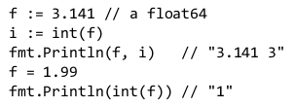
Many integer-to-integer conversions do not entail any change in value; they just tell the compiler how to interpret a value
But a conversion that narrows a big integer into a smaller one, or a conversion from integer to floating-point or vice versa, may change the value or lose precision

Slide 8
Floating Point Numbers
Go provides two sizes of floating-point numbers, float32 and float64. Their arithmetic properties are governed by the IEEE 754 standard implemented by all modern CPUs.
he limits of floating-point values can be found in the math package
The constant math.MaxFloat32, the largest float32, is about 3.4e38, and math.MaxFloat64 is about 1.8e308
A float32 provides approximately six decimal digits of precision, whereas a float64 provides about 15 digits

Slide 9

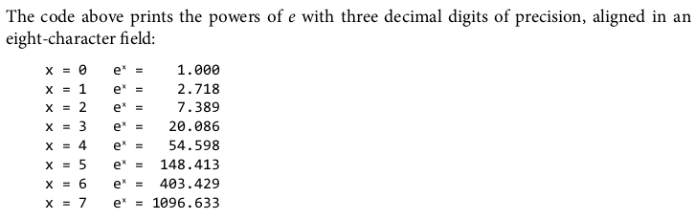
Floating-point values are conveniently printed with Printf’s %g verb, which chooses the most compact representation that has adequate precision, but for tables of data, the %e (exponent) or %f (no exponent) forms may be more appropriate

Slide 10
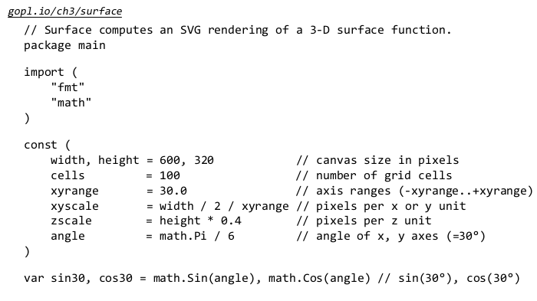
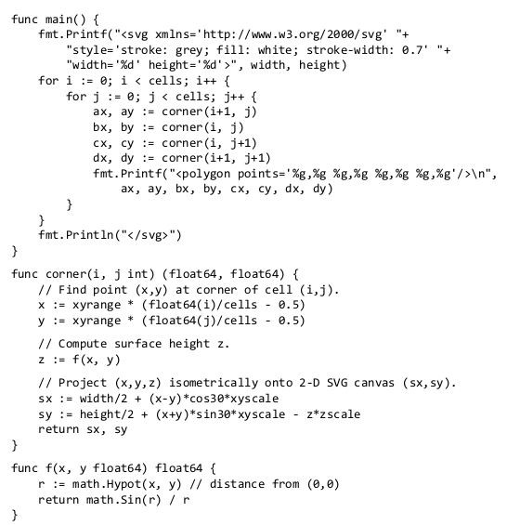

Slide 11
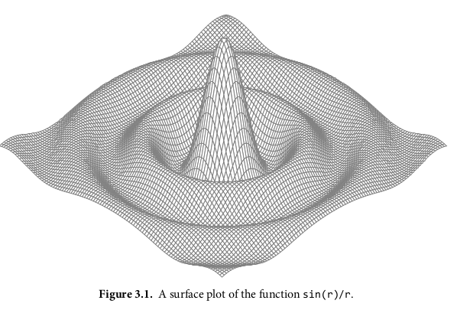

Slide 12

Complex Number
Go provides two sizes of complex numbers, complex64 and complex128, whose components are float32 and float64 respectively
The built-in function complex creates a complex number from its real and imaginary components, and the built-in real and imag functions extract those components

Slide 13


If a floating-point literal or decimal integer literal is immediately followed by i, such as 3.141592i or 2i, it becomes an imaginary literal, denoting a complex number with a zero real component
Under the rules for constant arithmetic, complex constants can be added to other constants (integer or floating point, real or imaginary), allowing us to write complex numbers naturally, like 1+2i, or equivalently, 2i+1

Slide 14
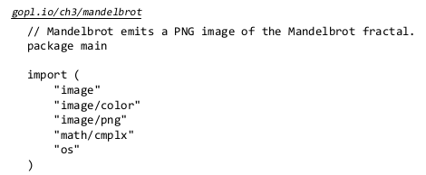
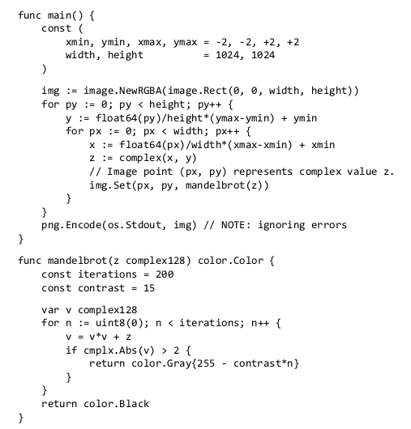
Mandlebrot set

Slide 15
Booleans
A value of type bool, or boolean, has only two possible values, true and false.
The conditions in if and for statements are booleans, and comparison operators like == and < produce a boolean result
The unary operator ! is logical negation, so !true is false, or, one might say, (!true==false)==true, although as a matter of style, we always simplify redundant boolean expressions like x==true to x.

Slide 16

Strings
A string is an immutable sequence of bytes
Strings may contain arbitrary data, including bytes with value 0, but usually they contain human-readable text
The built-in len function returns the number of bytes (not runes) in a string, and the index operation s[i] retrieves the i-th byte of string s, where 0 ≤ i < len(s).

Slide 17

Substring operations
The substring operation s[i:j] yields a new string consisting of the bytes of the original string starting at index i and continuing up to, but not including, the byte at index j.

Slide 18

Constant
Constants are expressions whose value is known to the compiler and whose evaluation is guaranteed to occur at compile time, not at run time
The underlying type of every constant is a basic type: boolean, string, or number.
A const declaration defines named values that look syntactically like variables but whose value is constant, which prevents accidental (or nefarious) changes during program execution.

Slide 19
References
https://go.dev/doc/install
https://www.golangprograms.com/go-language/data-type.html

